Slide 1
Notes:
Set up
Preconfigure app_manifest.json
Load https://featured.chat on a browser window and login with your Twitch account
Open https://github.com/gloveboxes/Azure-Sphere-Learning-Path/tree/master/samples/LearnTV/end_to_end_demo_avnet
Open https://cs110037ffe87b282f1.z23.web.core.windows.net/

Slide 2
Building secure IoT Solutions with Azure Sphere and Azure IoT Hub
David Glover | Microsoft | Cloud Developer Advocate
@dglover | linkedin.com/in/gloveboxes
Mustafa Saifee | Microsoft Student Ambassador | @immustu
Notes:
Hello and welcome to the Building Secure IoT Solutions with Azure Sphere and IoT Hub
My name is Dave glover, I’m a Microsoft Cloud Dev advocate, based in Sydney Australia with a focus on the Internet of Things It is also my great pleasure to introduce Mustafa one of our student ambassadors based in India
Mustafa would you like to tell us a bit about yourself?
Thank you Mustafa
Security is the biggest challenge facing the IoT industry
It is often overlooked in the rush to bring a new product to market.
Security should be at the heart of ever IoT discussion
Azure Sphere is our platform to build highly secure devices that are secure by default

Slide 3
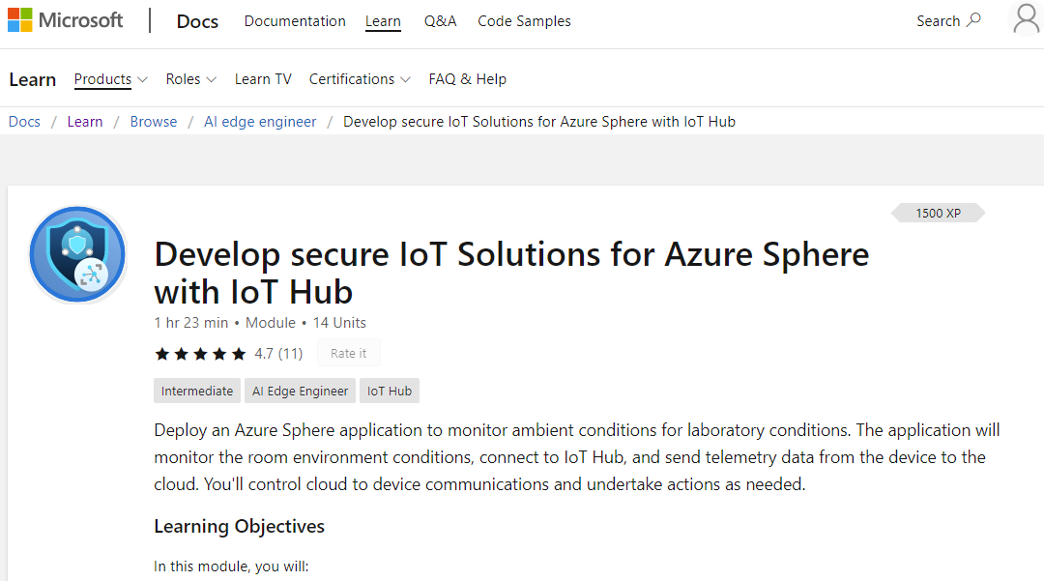
/learn
aka.ms/learn/iothub
Follow along on
Microsoft Learn
Notes:
DAVE TO TALK ABOUT THIS
In partnership with Oxford University we developed the Microsoft Learn Azure Sphere modules
This presentation is in support of this module
And there will be an opportunity for you to interact with one of the demos too

Slide 4

Q & A
Tweet us your questions
Use the hashtag #LearnTV
Notes:
This session is live
Moderators standing by to help answer your questions
And I will do my best to keep an eye on the questions too

Slide 5
Agenda
IoT security risks
Azure Sphere security
Azure IoT Hub & Device Provisioning Service Securely stream data to IoT Hub Remote control an Azure Sphere from IoT Hub
Notes:
Dave
And there will be an opportunity for you to interact with one of the demos too

Slide 6
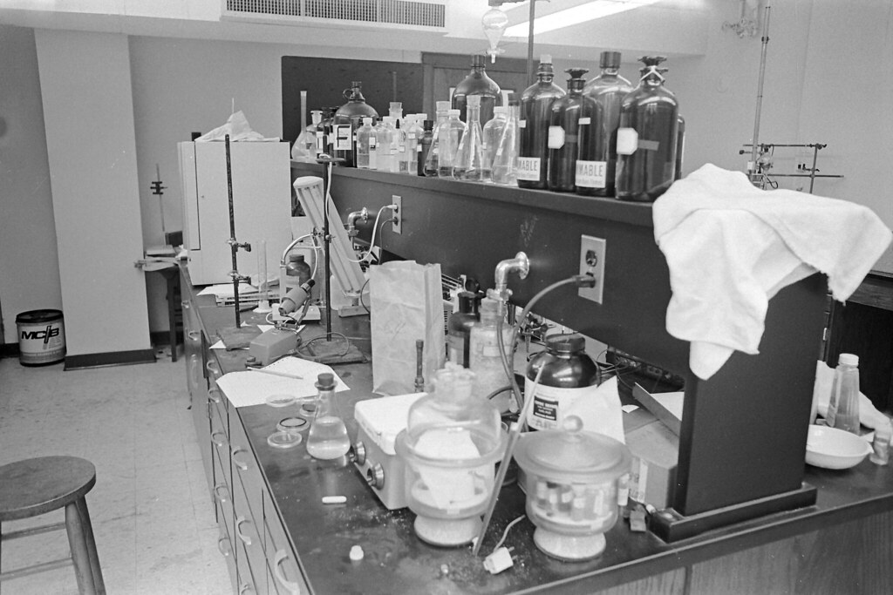
Lab scenario: Measuring a lab environment
Remote monitoring and control of a microbiology laboratory
Pressure
Temperature
Humidity
Light Control
Notes:
Mustafa: Intro lab scenario
Suppose you're a scientist in a microbiology laboratory who is responsible for storing samples from tests. You want to build a system that monitors the environment around the laboratory equipment in real time. This system would monitor the following room conditions:
Pressure
Light
Temperature
Humidity
Previously these were recorded manually by the lab assistants using sensors at regular intervals. Manual recording of ambient conditions is a tedious job which is also prone to human error. Having any issues with the sensors would invalidate the tests performed in the Lab environment.
Maintaining the room conditions accurately is critical for managing the laboratory. The lab needs to maintain the right conditions to help you get more accurate results. Any variation in the conditions can affect the equipment temperature during the storage and manipulation of the samples, specimens, and lab equipment. This could impact the ability to produce the correct and stable results and can also have an economic impact on the organization.

Slide 7



Cyberattacks On IOT Devices Surge 300% In 2019, ‘Measured In Billions’, Report Claims
“Industrial IoT to equip new era of corporate intruders coming in through devices”
“The IoT ransomware threat is more serious than you think”
“When smart gadgets spy on you: Your home life is less private than you think”
“Webcam firm recalls hackable devices after mighty Mirai botnet attack”
“The Lurking Danger of Medical Device Hackers”
“Hackers exploit casino’s smart thermometer to steal database info”
“Hacking critical infrastructure via a vending machine? The IOT reality”
Notes:
It is rare for a day to go by without some headline related to IoT security
Baby monitors, Toys, robot vacuum cleaners being used to spy on families
Heart pacemakers and cars Hijacked
Cyber attacks on cities - New Orleans https://www.foxnews.com/tech/new-orleans-cyberattack-costing-city-close-to-1m
Mira generated 623 Gbps attack from the Mirai botnet in 2016.”
Thousands of infected IoT devices used in for-profit anonymity service
Some 9,000 devices—mostly running Android, but also the Linux and Darwin operating Systems—have been corralled into the Interplanetary Storm
https://arstechnica.com/information-technology/2020/10/thousands-of-infected-iot-devices-used-in-for-profit-anonymity-service
Attacks have social, economic, and reputation implications.
None of use want to build devices that have to be recalled because of security issues.

Slide 8
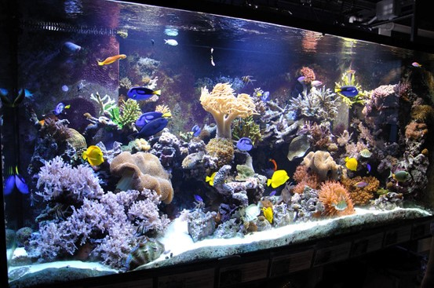
Casino Fish Tank Attack
Criminals Hacked A Fish Tank To Steal Data From A Casino
Notes:
M: yeah it is a great example where IoT security goes wrong
This is a great example where an IoT device was not used in the way it was intended
M: outro – hey dave can you tell me more about how Azure Sphere address security issues

Slide 9
Mitigating Security Risks
Complex, Expensive, Ongoing
Notes:
Next, I want to talk about approaches to mitigating security risks
As I’m sure you will appreciate, security is a journey
Getting security right is complex, expensive, highly specialised and ongoing
Attack vectors constantly changing and becoming more cunning
Microsoft has a long history building secure internet connected systems
We are applying those lessons to Azure Sphere

Slide 10
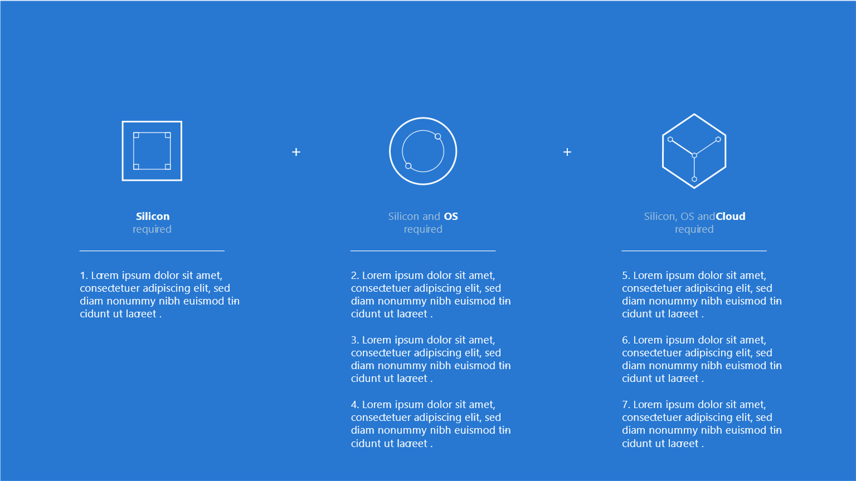

The 7 properties of highly secured devices Is your device highly secured or does it just have some security features?
Hardware Root of Trust
Defense in Depth
Small Trusted
Computing Base
Dynamic
Compartments
Certificate-Based Authentication
Error Reporting
Renewable Security
https://aka.ms/7properties
Notes:
Microsoft and the industry identified 7 properties to building highly-secure network connected devices.
I’m not going to go into each of these in any detail – see the link at bottom aka.ms/7properties
A Hardware root of trust identifies a device with unforgeable cryptographic keys protected by hw
Dynamic Compartments hw barriers between software components that prevent a security breach in one layer reaching another layer
Certificate-based authentication proven using Hardware Root of Trust cryptographic key to prove the identity of the device
Renewable security. The device software is automatically updated to correct known vulnerabilities or security breaches.
Failure Reporting A software failure, such as buffer overrun attack should be reported to cloud based failure analysis systems
Defense in Depth multiple layers of protection, each layer verifying the next layer is secure.
A Small trusted computing base, hw and sw, together to protect the device identity and enforce security policies.

Slide 11


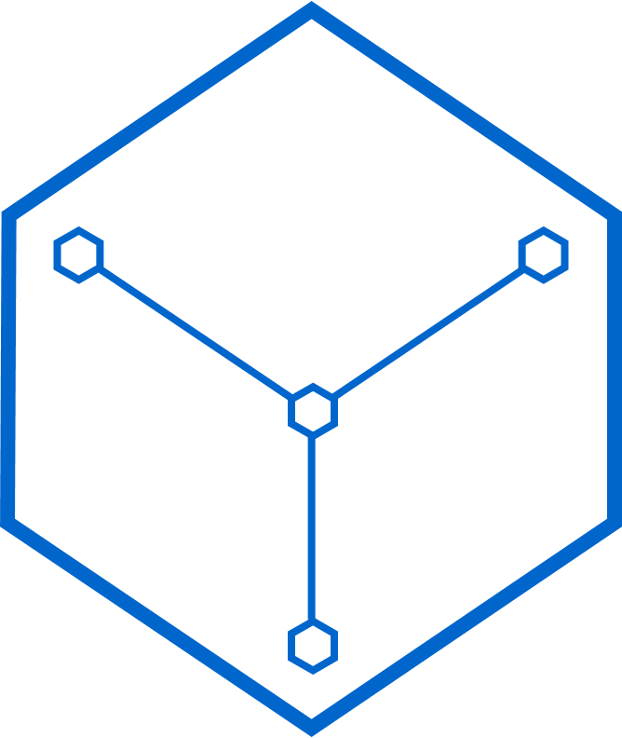
Azure Sphere 3 components implement the 7 properties
The Azure Sphere OS with ongoing updates creates a Microsoft-secured software platform
Azure Sphere certified Microcontroller (MCU), from our silicon partners, with built-in Microsoft hardware root of trust.
The Azure Sphere Security Service guards every Azure Sphere device.
It brokers trust, detects emerging threats, renews device security, and app reporting.
Notes:
D: Talk about Azure Sphere
It Implements the 7 properties of secure systems - Secure by default – everything is locked down!
Azure Sphere is a new class of secured, connected, crossover MCUs.
It supports real-time processing alongside a high level secure OS.
Azure Sphere certified MCUs: Provide secure, dependable hardware root of trust.
Azure Sphere OS with ongoing updates create the secure IoT platform. Azure OS is a hardened version of embedded Linux.
Azure Sphere Security Service: It brokers trust, detects emerging threats, and renews device security
Build secure, internet connected solutions. Updated, controlled, monitored and maintained remotely.

Slide 12
Azure Sphere Microcontroller Silicon Design
Microsoft
Pluton
Security Subsystem
FLASH
≥ 4MB
Network Connection WiFi in first chips
Firewall
Firewall
Firewall
ARM Cortex-A7
optimized for low power
SRAM
≥ 4MB
2 x ARM Cortex-M4F
for real time processing
Firewall
Firewall
Firewall
Multiplexed I/O
GPIO
PWM
TDM
I2S
UART
I2C
SPI
ADC
Cores highlighted in red are application cores
Notes:
Let’s look at the Azure Sphere MCU design.
5 Core Microcontroller
Highlighted in red
2 x Real time cores
1 x High level core
It’s a Multi Core Microcontroller
2 x Cortex-M4F cores. Support for real-time, bare metal processing – Existing code, Azure ThreadX, FreeRTOS, Tiny Machine Learning Models
Connectivity Core for Dual Band Wifi - shipping in first chips (other connectivity to follow)
The Pluton Security System Core responsible for implementing security policies
Firewalls – two-fold
Silicon countermeasures to ensure that IO peripherals are only accessible by the core they are mapped
Memory Management Unit ensure hardware enforced memory spaces
Network endpoint protection
Cortex-A. Crossover processor
Has full Memory management unit to provide virtualised memory addressing for software compartments.
Attestation is a mechanism for software to prove its identity.
MT3620 is a highly integrated single chip tri-core MCU designed to meet the requirements of modern, robust internet-connected devices. It leverages the Microsoft Azure Sphere security architecture to provide an unprecedented level of security to connected device manufacturers. For the lifetime of the device the Azure Sphere solution provides device authentication and attestation, supports remote over-the-air software updates to maintain security in the face of evolving attacks, and automates error logging and reporting. Please refer to the “Azure Sphere Platform Overview” document from Microsoft for more information.
MT3620 features an application processor subsystem based on an ARM Cortex-A7 core which runs at up to 500MHz. The chip also includes two general purpose ARM CortexM4F I/O subsystems, each of which runs at up to 200MHz. These subsystems were designed to support real-time requirements when interfacing with a variety of on-chip peripherals including UART, I2C, SPI, I2S, and ADC. They are completely general-purpose Cortex-M4F units which may be tailored to specific application requirements. On-chip peripherals may be mapped to any of the three end-user accessible cores, including the CA7.
In addition to these three end-user accessible cores, MT3620 contains a security subsystem with its own dedicated CM4F core for secure boot and secure system operation. There is also a Wi-Fi subsystem controlled by a dedicated N9 32-bit RISC core. This contains a 1x1 dual-band 802.11a/b/g/n radio, baseband and MAC designed to support both low power and high throughput applications without placing computational load on the user-accessible cores. MT3620 also includes over 5MB of embedded RAM, split among the various cores. There is a fully-integrated PMU and a real-time clock. Flash memory is integrated in the MT3620 package; see section 3.2 for ordering information. Please refer to the “Azure Sphere MT3620 Support Status” document from Microsoft for information about how much memory and which hardware features are available to enduser applications. Only hardware features supported by the Azure Sphere solution are available to MT3620 end-users.
TCM, Tightly-Coupled Memory is one (or multiple) small, dedicated memory region that as the name implies is very close to the CPU. The main benefit of it is, that the CPU can access the TCM every cycle. Contrary to the ordinary memory there is no cache involved which makes all memory accesses predictable.
The main use of TCM is to store performance critical data and code. Interrupt handlers, data for real-time tasks and OS control structures are a common example.
In computer security, a side-channel attack is any attack based on information gained from the implementation of a computer system, rather than weaknesses in the implemented algorithm itself (e.g. cryptanalysis and software bugs). Timing information, power consumption, electromagnetic leaks or even sound can provide an extra source of information, which can be exploited.
PMU = Power Management Unit
https://docs.microsoft.com/en-au/azure-sphere/product-overview/what-is-azure-sphere
https://d86o2zu8ugzlg.cloudfront.net/mediatek-craft/documents/MediaTek-MT3620-Product-Brief-PDFMT3620PBA4-0919.pdf

Slide 13

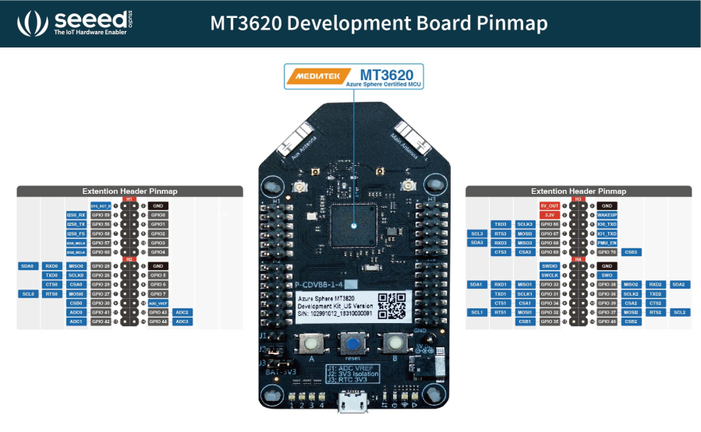
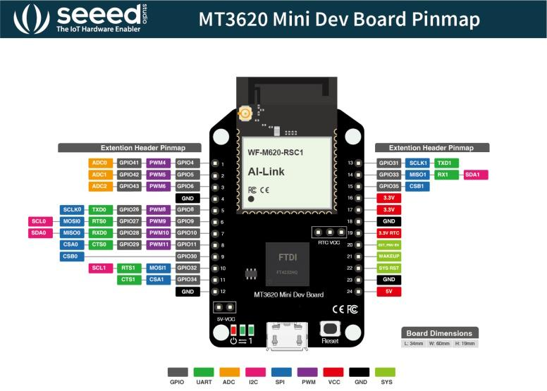
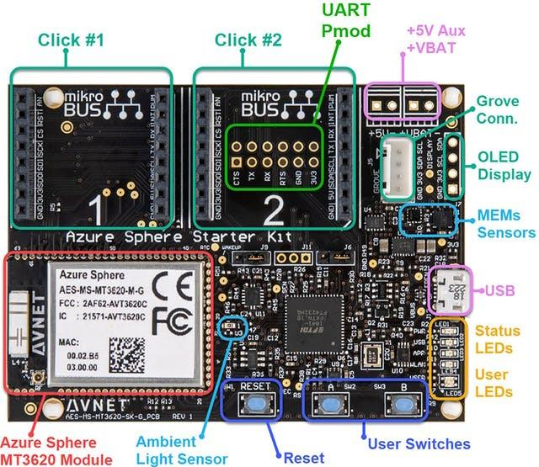
Azure Sphere Developer Boards
There are multiple types of boards available to use
https://docs.microsoft.com/en-us/learn/modules/develop-secure-iot-solutions-azure-sphere-iot-hub/3-gpio-hardware-interfaces
Notes:
M: Hey M, can you tell us about the Azure Sphere Boards – Dave to click on the url
M: to hand over to D
https://docs.microsoft.com/en-us/learn/modules/develop-secure-iot-solutions-azure-sphere-iot-hub/3-gpio-hardware-interfaces
There are multiple types of boards available to use; let's look at the first one.

Slide 14
Components needed
The components you'll need to know are:
Azure Sphere SDK
Azure Sphere tenant
You claim and can remotely manage your Azure Spheres
Azure Sphere OS
Azure Sphere Security Service
Notes:
The components you'll need to know are:
Azure Sphere SDK
Azure Sphere tenant
Azure Sphere OS
Azure Sphere Security Service – it delivers security updates

Slide 15
IoT Reference Architecture
IoT Devices
DPS
Reporting
Power BI
IP Capable devices
send data from devices to Cloud
Configure and control
Visualize data and learnings
Azure
IoT Hub
Cloud Gateway
Stream
Analytics Processing
Business Integration
Stream processing and
rules evaluations over data
Data Transformation
Machine Learning
Storage
Cold
Path store
Warm
Path store
Store data
Integrate with Business process
Things
Insights
Actions
Notes:
D:
Before we dive into building secure IoT applications with Azure Sphere
Recap the typical architecture of an IoT solution
Things :
Directly connected, via a gateway, or intelligent edge devices
If you are a device developer you need to be thinking about message types, data types, serialisation, and metadata as these simply data processing in the cloud.
Insights
Stream processing, data transformation, and Storing
Remember to consider the volume and value of data as this will guide you as to where you are storing data
Actions
Integration with business systems
Make better business decision based on data
Opportunities to automate
Batch analytics and training machine learning

Slide 16
Provisioning Demo Azure IoT Hub Device Provisioning Service
https://docs.microsoft.com/en-us/learn/modules/develop-secure-iot-solutions-azure-sphere-iot-hub/8-exercise-connect-room-environment-monitor
Notes:
Shared screen will go to M:
M: will do the talk on provisioning the IoT Hub and the Device Provisioning service
https://docs.microsoft.com/en-us/learn/modules/develop-secure-iot-solutions-azure-sphere-iot-hub/8-exercise-connect-room-environment-monitor

Slide 17
Demo Connect an Azure Sphere to Azure IoT Hub
https://docs.microsoft.com/en-us/learn/modules/develop-secure-iot-solutions-azure-sphere-iot-hub/8-exercise-connect-room-environment-monitor
Notes:
D: switch back to sharing screen – and do the code demo
M: Switch back to M and he will be able to display the sensor data from IoT Explorer

Slide 18
Remote control lab light switch with Azure IoT Direct Methods
Notes:
Dave talk about remote control
Mustafa will be controlling the application

Slide 19

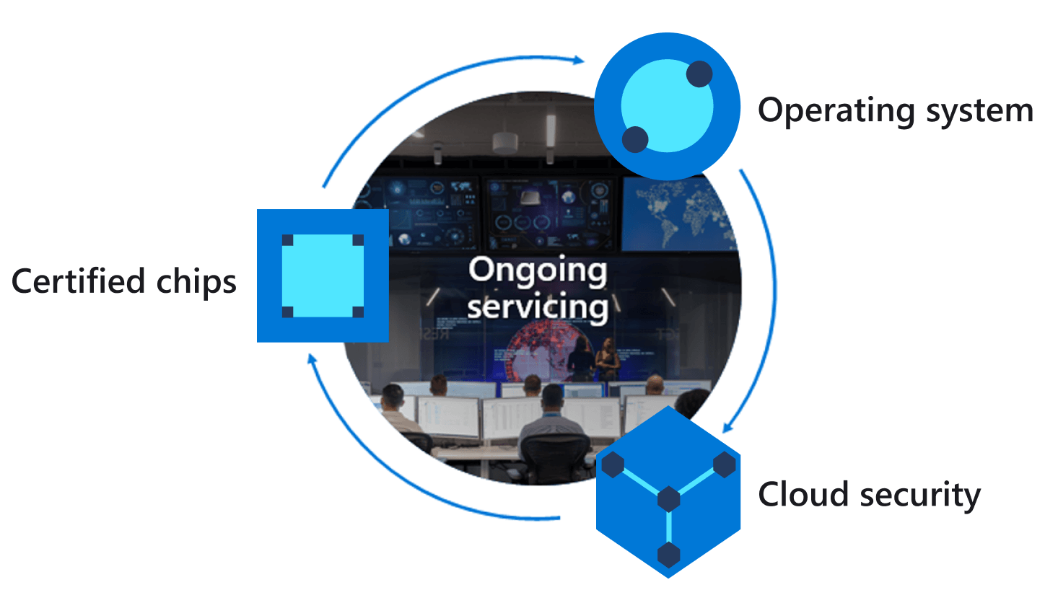
The direct method pattern
Azure IoT Hub application
Azure Sphere
Invoke LightControl direct method
Method Request
Direct method LightControl handler function
2
Apply action
3
Method Response
Direct method handler response
1
4
Notes:
Dave to discuss

Slide 20
Demo Lab light control with Azure IoT Direct methods
http://aka.ms/learn/iothub/demo
Notes:
Dave to do the code – will put breakpoint
Mustafa – you will invoke the method
Dave- switch and step through
Tweet on to #LearnTV http://aka.ms/learn/iothub/demo

Slide 21
Setting Lab Environment Sensor rate with Azure IoT Device Twins
Notes:
D: Current the code sends a message to Iot hub every 5 seconds
But we want to change that
We are going to use device twins

Slide 22

Setting Device Twins on Device Properties
Azure IoT Hub application
Azure IoT Central properties (Device Twins)
Azure Sphere
Update desired sensor measure rate configuration
Properties.Desired
Device twin
sensor measure rate handler
Data
1
2
Change sensor measure Rate
3
Properties.Reported
Get twin or query
Data
Report configuration
5
4
Notes:
Change the rate the sensor os measured

Slide 23
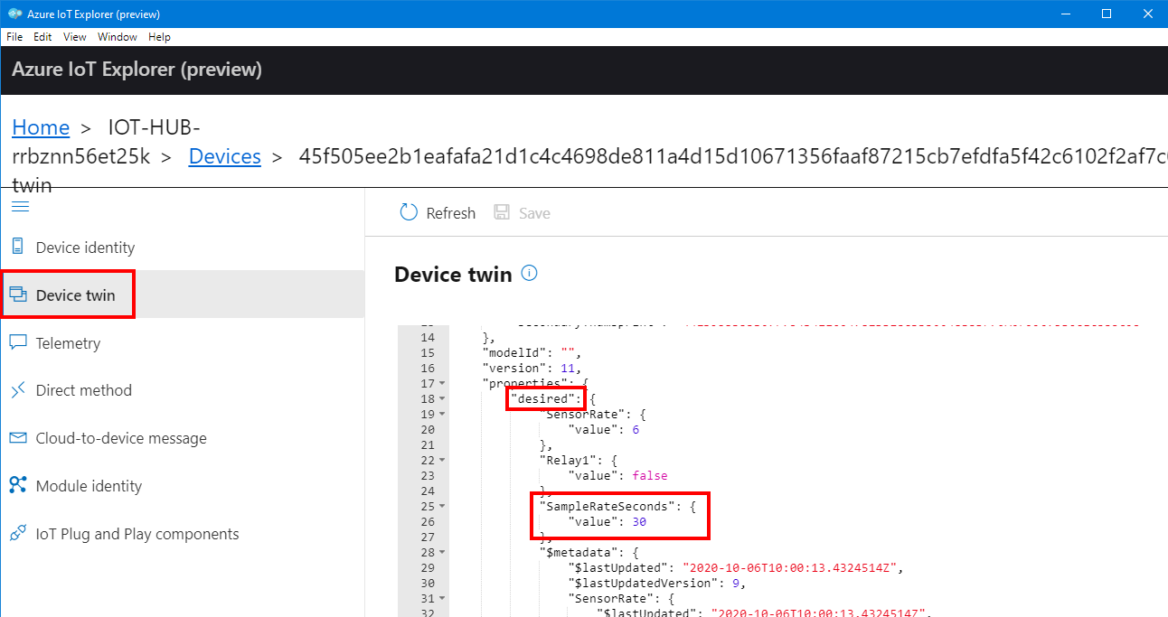
Azure IoT Device twins (Azure IoT Explorer)
Notes:
Azure IoT Central device properties are defined in Device templates.

Slide 24
Demo Set lab environment sensor sample rate with Device Twins Sphere and Device Twins
Notes:
Dave: do the code demo – run and set the breakpoint
Mustafa: now you need to update the device twin – so switch to his screen and he will update the Device twin
Dave: The code will be stopped at the breakpoint

Slide 25
Knowledge Check

Slide 26
Question 1
In the Azure Sphere ecosystem, which component is missing from the following list? - Azure Sphere SDK, Azure Sphere tenant, Azure Sphere OS
A) Azure Sphere API
B) Azure Sphere Security Service
C) Azure Sphere Security Key
Notes:
D:
Explanation: Azure Sphere Security Service is a key component of the Azure Sphere ecosystem
B) Azure Sphere Security Service

Slide 27
Question 1
In the Azure Sphere ecosystem, which component is missing from the following list? - Azure Sphere SDK, Azure Sphere tenant, Azure Sphere OS
A) Azure Sphere API
B) Azure Sphere Security Service
C) Azure Sphere Security Key
Notes:
D: Explanation: Azure Sphere Security Service is a key component of the Azure Sphere ecosystem

Slide 28
Question 2
Your organization created an Azure Sphere tenant and then claims each of its devices into that tenant – what function does this accomplish?
A) So that you can manage those devices remotely and securely.
B) The tenant allows devices to communicate better with other tenants.
C) Your organization can name individual devices.
Notes:
M: read the question
Explanation: The tenant allows you to manage devices remotely and securely.

Slide 29
Question 2
Your organization created an Azure Sphere tenant and then claims each of its devices into that tenant – what function does this accomplish?
A) So that you can manage those devices remotely and securely.
B) The tenant allows devices to communicate better with other tenants.
C) Your organization can name individual devices.
Notes:
Explanation: The tenant allows you to manage devices remotely and securely.

Slide 30
Question 3
If the Azure Sphere Security Service were missing – what function could you not perform?
A) You can't receive alerts for anomalies.
B) You can't maintain the operating system security.
C) You can't get the latest security updates to the Azure Sphere devices.
Notes:
D:
Explanation: You can't get the latest security updates to the Azure Sphere devices.

Slide 31
Question 3
If the Azure Sphere Security Service were missing – what function could you not perform?
A) You can't receive alerts for anomalies.
B) You can't maintain the operating system security.
C) You can't get the latest security updates to the Azure Sphere devices.
Notes:
Explanation: You can't get the latest security updates to the Azure Sphere devices.

Slide 32
Summary

Slide 33
Summary
Security must be part of your IoT story
Azure Sphere delivers a highly secure IoT device platform
Secure by default with ongoing security updates
Notes:
Using an application built around the Azure Sphere, you can securely capture data and send it to the cloud for additional purposes. You firstly configure the Azure Sphere Application to connect to Azure IoT and when you execute an application, it connects and transmits data to the cloud. You can monitor the data being sent on the Azure IoT. You can send specific commands from the IoT Central to the device to control the device parameters. It can also send alerts messages to inform the authorized person.
Consider the scenario of monitoring the environment parameters such as temperature, air pressure, humidity, and light within a laboratory setting. You want to build and automate a new solution within the lab. This solution will include the sensors deployed in the lab that will record the ambient environmental conditions and transmit them securely to the cloud.
Without the Azure Sphere-based application, you would need to manually record these conditions at regular intervals and keep a record of it. And any variation in the Lab environment can't be detected in real time. Using this solution, we'll have the ability to produce accurate and stable results in near real time.

Slide 34
/learn
aka.ms/learn/iothub
Follow along on
Microsoft Learn

Slide 35
Upcoming sessions Mark your calendar
Session name | Time | Location/online link
Create a DevOps Solution for Azure IoT Edge Devices | October 12 1:00 PM PDT | aka.ms/oxDevOps
Develop Secure IoT Solutions with Azure Sphere and IoT Hub | October 13 1:00 PM PDT | aka.ms/oxIoTHub
Cognitive Services with Azure IoT Edge | October 19 1:00 PM PDT | aka.ms/oxCog
Develop Secure IoT Solutions with Azure Sphere and IoT Central | October 20 1:00 PM PDT | aka.ms/oxIotCentral

Slide 36
Q & A
Tweet us your questions
Use the hashtag #LearnTV
Notes:
Moderators standing by
Ask now all feel free to connect with me on @dglover or LinkedIn

